Slide 1
Recommendation Engine
Trevor Judd, Maria McConkey, Kristen Patterson
Notes:
Maria McConkey
Recommendation Engine, a challenge proposed by DataHack.
Trevor Judd, Maria McConkey, and Kristen Patterson

Slide 2
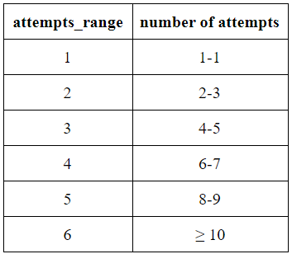
Problem Statement
Online judging platforms for programming problems need an effective recommendation engine to able to recommend new engaging and challenging problems to users.
To build an effective recommendation engine, create good models given data about the users, users’ submissions, and problems and attempts range as the target variable.
Notes:
Maria McConkey
The challenge: Online judging platforms for programming problems need an effective recommendation engine to be able to recommend new engaging and challenging problems to users. However, it is difficult for online judges to determine how challenging a given problem will be for individual users. Recommending problems that are too challenging will cause the user to give up, and recommending problems that are too easy will not adequately test the user’s skills. DataHack provided data about the users, users’ submissions, and problems as well as picked attempts_range as the target variable to build a good model for the recommendation engine.
Producing a good model will help online judge platforms be able to engage and challenge their users which then will allow users to be able to push the boundaries of their skills.

Slide 3

Evaluation Metric
To evaluate models, the F1 score was used.
Based on the F1 scores of similar models that have been built for this challenge, an F1 score of 0.4 has been deemed minimally acceptable for any one of our predictive models.
Notes:
Maria McConkey
Along with providing the data and picking the target variable, DataHack also selected the F1 score to evaluate the models. Based on the F1 scores of similar models that have been built for this challenge, an F1 score of 0.4 has been deemed minimally acceptable for any one of our models.

Slide 4
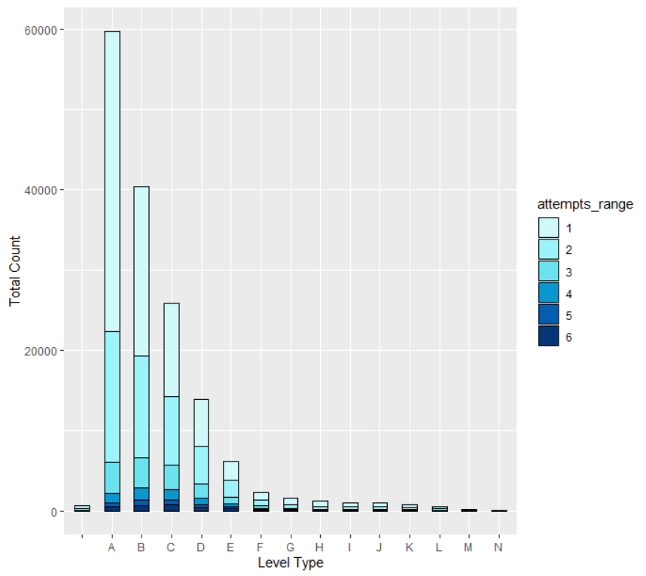
Initial Hypothesis
Is there a correlation between the difficulty level of the problem and the attempts range?
Confirmation of this hypothesis was the start of our exploratory data analysis.
Notes:
Trevor Judd

Slide 5
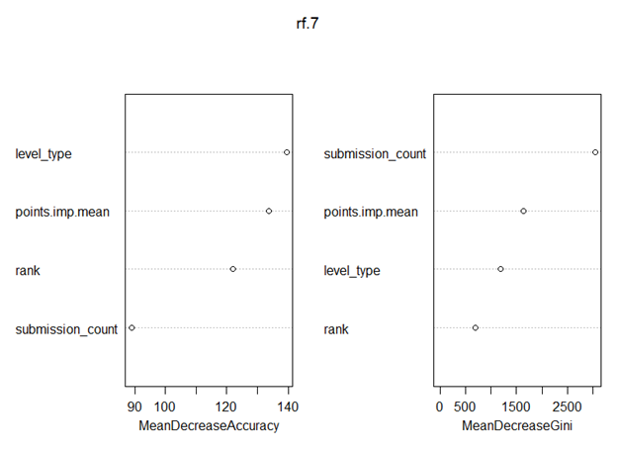
Method: Random Forest
randomForest() implements Breiman's random forest algorithm for both classification and regression.
It can also be used in unsupervised learning for assessing proximities among data points.
This was the only model we could get to work without having to “whittle down” the data.
Notes:
Trevor Judd

Slide 6
Method: 10-Fold Cross Validation
This was the trickiest part of the project.
We wanted to verify the error rate of our Random Forest.
10-Fold Cross Validation slowed our machines down to a crawl, so we tested it using a very small subset of the data (1000 entries).
We kept getting strange errors, and the computers still ran slow.
We tried 5-Fold then 3-Fold Cross Validation and we kept getting the same error.
We think is has something to do with the limitations of the Factor data type in R.
Notes:
Kristen Patterson: We attempted to verify the accuracy of our model using 10-Fold Cross Validation.However, proposed set sizes were too large, slowing down our computers to the point of being unusable. We tried again using an incredibly small fraction of the data, as well as reducing the number of folds, but we were unsuccessful, and received strange errors.

Slide 7
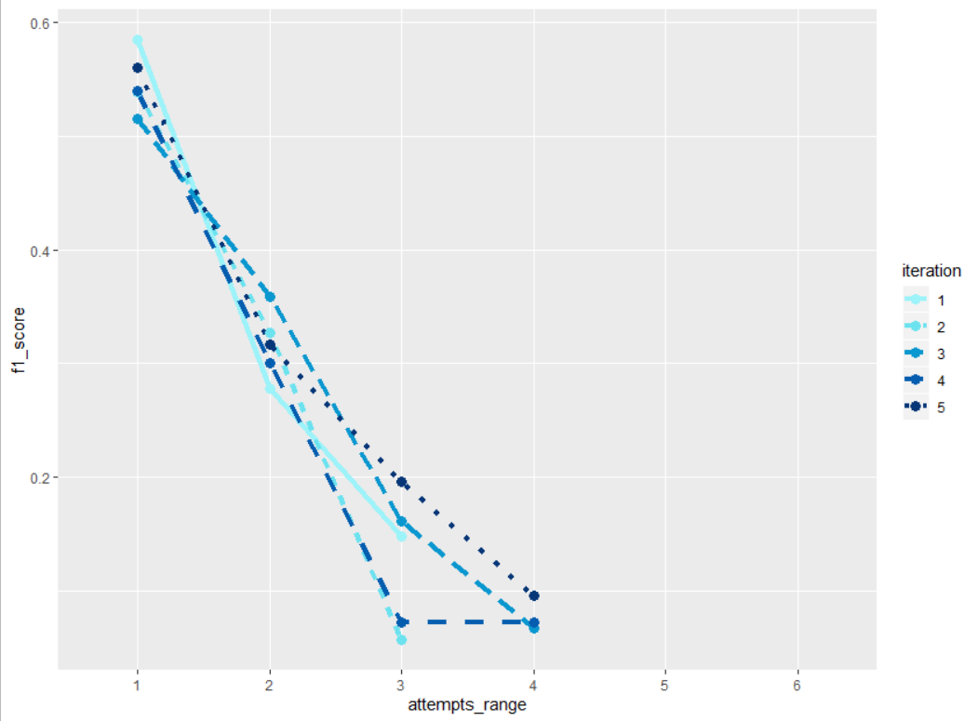
Method: K-Nearest Neighbors (K-NN)
K-NN compares labeled data and unlabeled data to designate labels to the unlabeled data using majority vote of k similar labeled objects.
Euclidean Squared Distance was used to decide similarity.
Due to hardware limitation, the dataset set had to be trimmed to 1% of its original size to get the model to work.
Notes:
Maria McConkey
K-Nearest Neighbors compares labeled data and unlabeled data to designate labels to the unlabeled data using majority vote of k similar labeled objects. Usually, k is selected by repeating K-NN with various k values and figuring out which one had the lowest misclassification rate, and similarity is determined by Euclidean Distance. Due to hardware limitations, k was set to 1, and Euclidean Squared Distance was used as the similarity metric. The dataset also had to be trimmed to a sample size of 1% to get the model to work. To determine if K-Nearest Neighbors could be a good possibility as a model if given better hardware, K-NN was ran five times with a randomly selected 1% sample each time. The results show the F1 score for each attempts range class and is graphed on the right. The attempts range classes with higher F1 scores are the classes that have more data. This indicates that K-NN may produce good results if there is enough data which means there is a need for better hardware.

Slide 8
Tools
R
R Libraries
Random Forest | Cross Validation | K-Nearest Neighbors | Others
randomForest | caret doSNOW rpart rpart.plot | neighbr | ggplot2 stringr e1071
Notes:
Kristen Patterson: We used R and R Studio, with additional libraries to assist us in modeling and plotting.

Slide 9
Results
Using the Random Forest algorithm, we were able to produce a predictive model with an F1 score of 0.403.
The highest F1 score shown on the Data Hack website is 0.51. The lowest was a 0.
10-Fold Cross Validation and K-Nearest Neighbors could not produce final results due to dataset size and hardware limitations.
Notes:
Trevor Judd

Slide 10
Lesson Learned
R was originally designed with small datasets in mind (i.e. datasets with a few thousand members).
We were working with datasets that had over 200,000 members.
We encountered several technical limitations which convinced us of the necessity of working with smaller datasets if possible because our computers could barely crunch the numbers without crashing.
Notes:
Kristen Patterson: Along with learning more about how R can be used to analyze real world data, our team learned that our computers were not built to handle datasets as large as 200,000 thousand items, and that R was originally designed for much smaller data sets.

